Slide 1
Year 4 Welcome Event
Monday 11th September 2023

Slide 2
The Year 4 Team
Sarah Galpin/ Amanda Evans
Grace Higham
Antonia Fletcher
Mariella Decelis

Slide 3
Curriculum
Autumn Term Topics
History: Ancient Egypt
Science: Electricity
Computing: E safety and the Internet
R.E: Journey of life and death
Music: Strings
Art/D.T: Repeating Pattern
Spanish: Describing Me & others
PSHE: Being me in my world

Slide 4
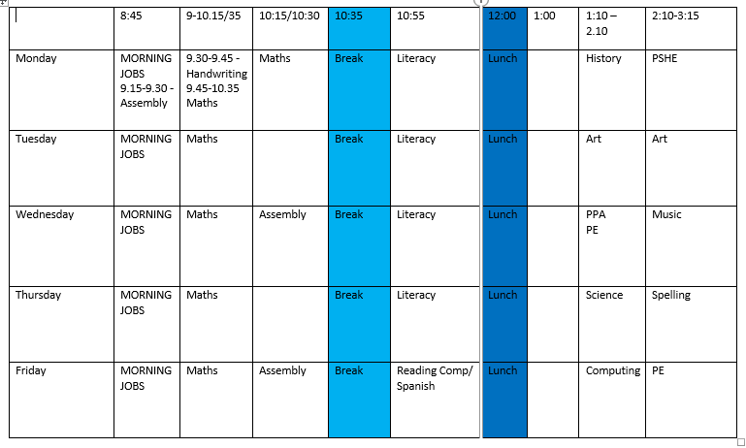

Slide 5
Homework
Friday – Maths Homework + Reading Comprehension/ Grammar to be handed in on the Friday of the following week
Times tables
Spellings - Now embedded within lessons with activities and games to be set weekly on Spelling Shed
We expect children to read every day for between 10 and 20 minutes please use the reading diary. We will read with each child weekly as well as have weekly reading comprehension lessons

Slide 6
Times table test
Monday 3rd June – 2 week window opens

Slide 7
Expectations
Punctuality
School uniform
PE kit – children to come to school in PE kit on Wednesday and Friday
Homework – support at home as required.
Absence / holidays
Behaviour policy & partner classes

Slide 8
Trips
Visits planned throughout the year to tie in with our topics
November – visit to New Walk Museum Leicester – (History – Egyptians)
March – Perlethorpe River Visit (Geography - Rivers) & Southwell Minster (RE - pilgrimages)
Residential in the summer term camping at Wollaton Park

Slide 9
Class Dojo

Slide 10
Volunteers
Reading volunteers
Any expertise welcome

Slide 11
Questions
a.evans@haydn.nottingham.sch.uk
s.galpin@haydn.Nottingham.sch.uk
g.higham@haydn.nottingham.sch.uk

Slide 12
Thank you for your coming…
… and welcome to Year 4!

